Slide 1
Multi-model databases
Bauman MSTU
Zhuravlev N.V., student
IU5-24М

Slide 2

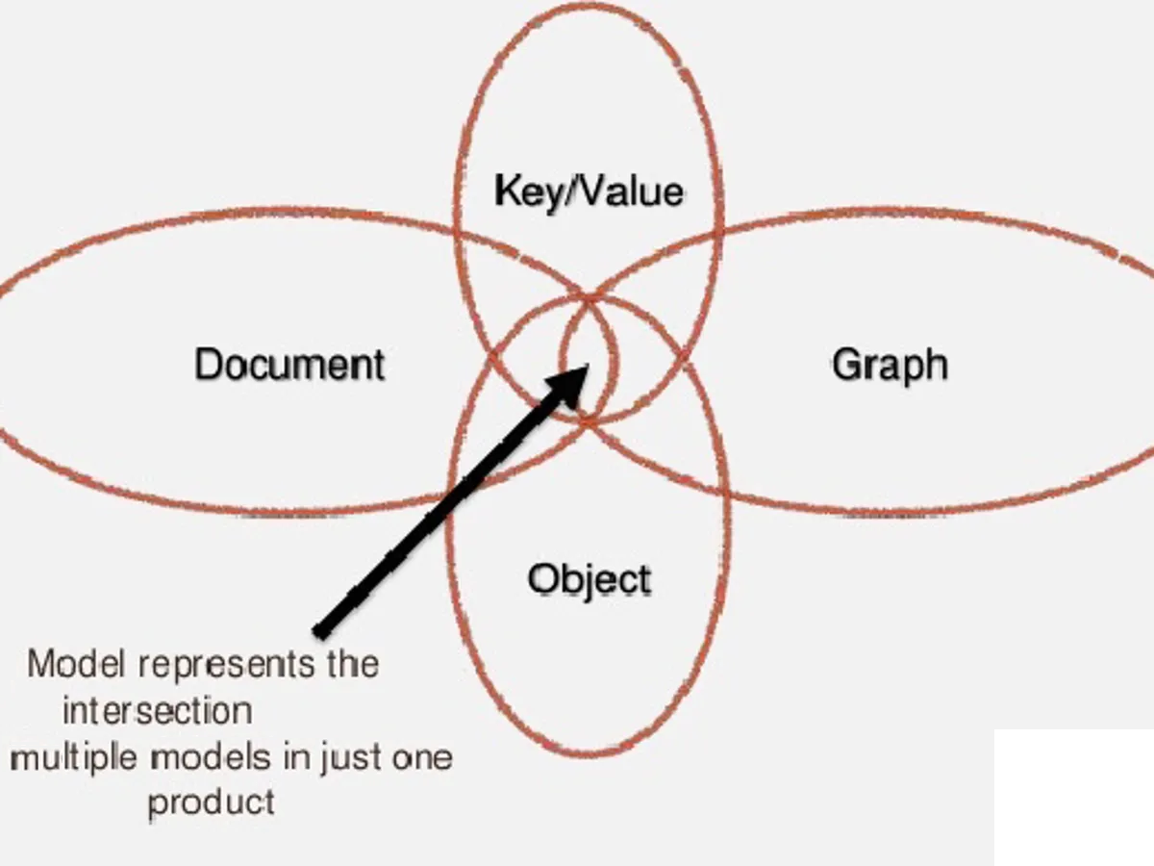
What is multi-model databases
A multi-model database is a database designed to support multiple data models in a single data storage system. This means that such a system can store, index, and query data across multiple models. This type of database provides a single interface for consistency, security, and data access, and eliminates the need for complex conversions and migrations between different databases

Slide 3

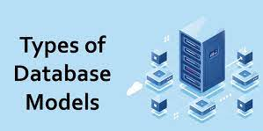

Database Models
Key-value
Column family
Document
Graph

Slide 4



Types of MMBD construction
Polyglot persistence
Multi-model DB based on the relational model
Multi-model DB based on the document model
MMDB “without main model”

Slide 5




Example MMDB
Example MMDB:
MongoDB (document, key-value)
ArangoDB (graph, document, key-value)
OrientDB (graph, document, key-value)
MarkLogic (graph, document)

Slide 6
Thank you!
Bauman MSTU
Zhuravlev N.V.
IU5-24М

